Slide 1
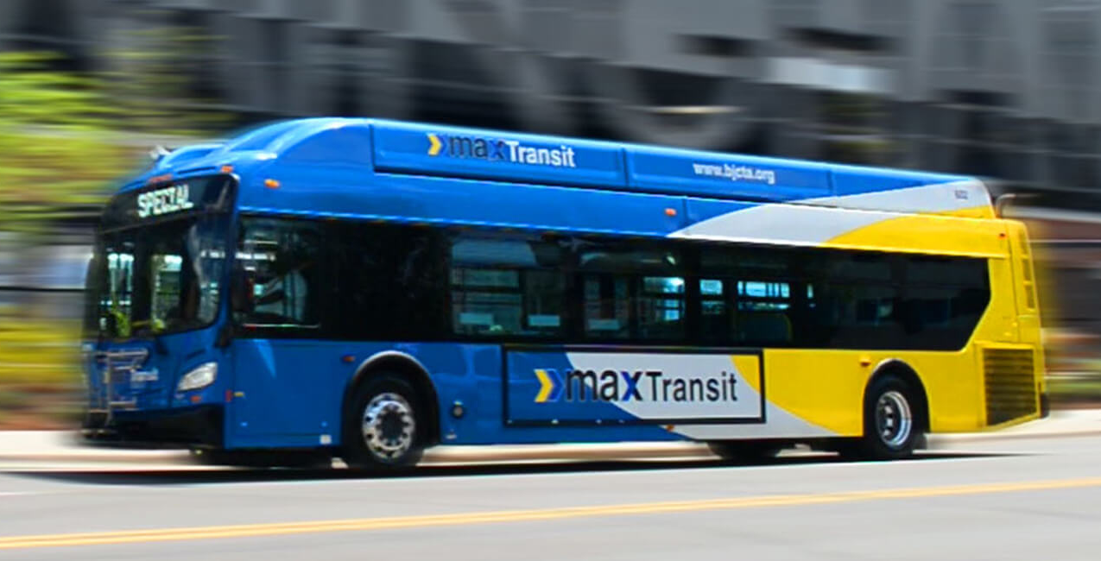
Moving Forward with MAX
2020-2021 Comprehensive Operational Analysis
Draft Network Plan

Slide 2
BJCTA QUICK FACTS
BJCTA was created by legislative act in 1972
MAX (Metro Area Express) tagline was created in 1982
BJCTA is funded by local and Federal funds. Local funds include the Jefferson County sales tax distribution, a Beer Tax, Ad Valorem Property Tax and farebox revenues
Approximately 275 employees
Fleet
40 Paratransit buses 70 Fixed route buses 2 Microtransit buses (MAX Direct)

Slide 3
THE PAST. THE PRESENT. THE FUTURE.
ISSUES | IMPROVEMENTS | INITIATIVES
No internal or external synergy Outdated and unsafe Operations and Maintenance facility Not adhering to Enabling Legislation— HB627 Level of service provided to largest municipal partner did not match the revenue received Inadequate leadership Outdated and unreliable technology | Enhanced full board and committee process (Consent Agenda) Frequent communication with city, municipal partners, customers, and the community at-large to cultivate meaningful partnerships Procedural Safeguards put in place to ensure adherence to the enabling legislation Level of service as close as possible to funds allocated by each municipality Filled vacancies with experienced candidates Identified and began the process of replacing outdate technology | Positioning BJCTA to be the Mobility Manager for the Region Initiating internal controls to safeguard assets and ensure adherence to policies Comprehensive Operations Analysis (COA) and Transit Development Plan Conduct a total assessment of Operations and Maintenance Departments Conduct feasibility assessment and determine site of the new Maintenance Facility

Slide 4
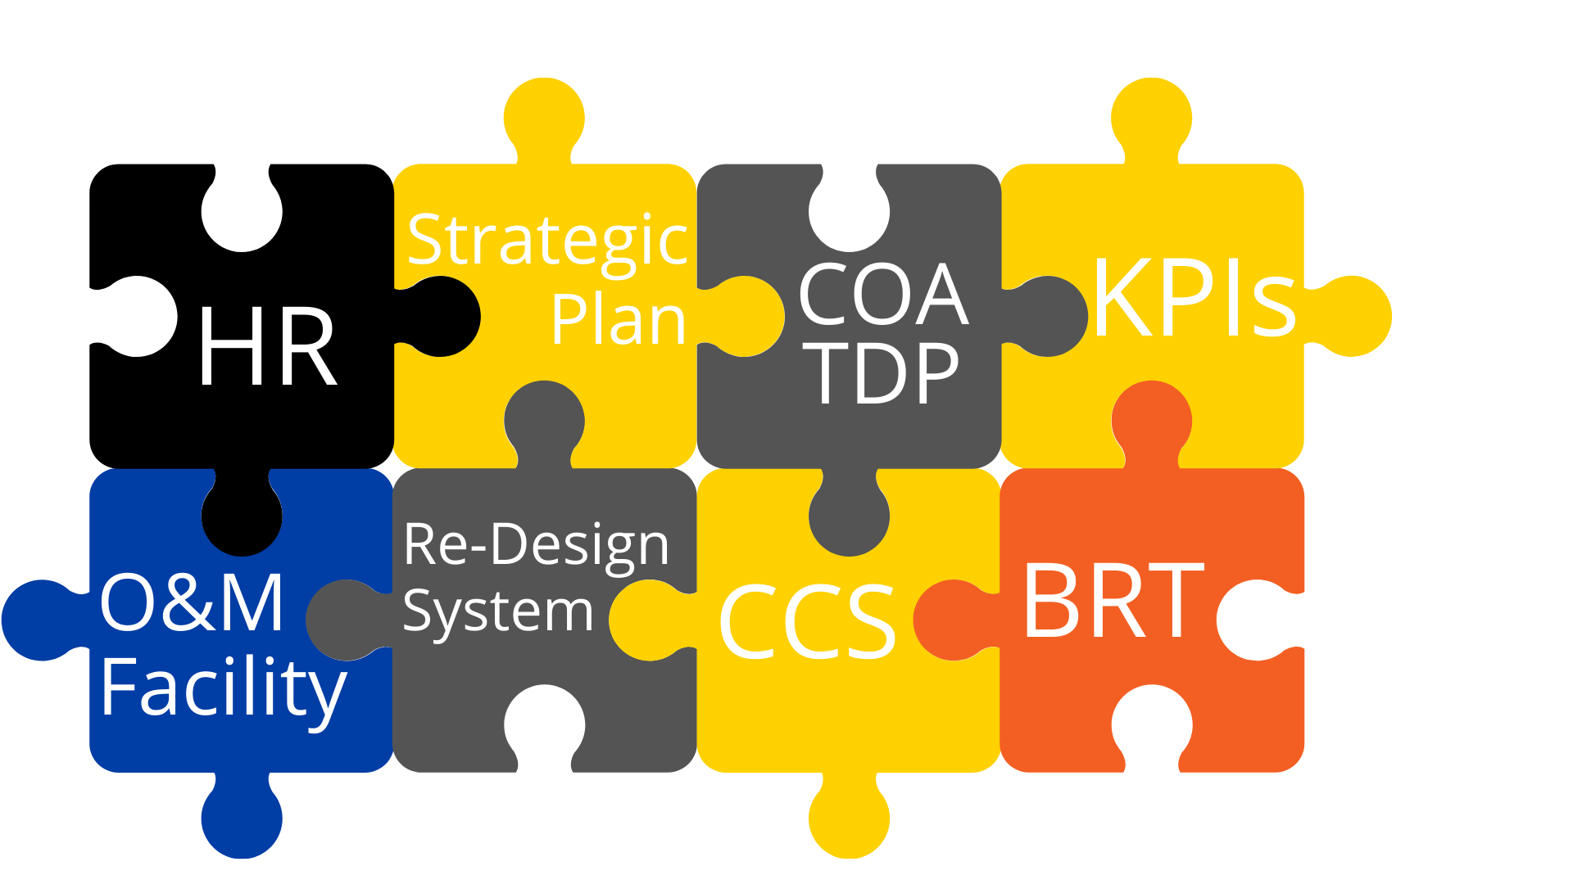
MAJOR INITIATIVES FY2021 - FY2022
Bus Rapid Transit - Birmingham Xpress
BRT Safety Security Program, Ridership Forecast, Community Education
Transit Development Plan/Comprehensive Operational Analysis (TDP & COA)
Customer & Community Satisfaction Surveys
Human Resources Studies
Operations & Maintenance Center
Strategic Plan
Performance Measurement & Benchmarking (KPI)

Slide 5
CURRENT PROJECTS
NeoGov for Human Resources
Implement a full HR system for BJCTA. ETC 3/2021
Ecolane Fixed Route Phase 1-4
Replace AVAIL CAD/AVL . ETC 4/2021 (Phase 1)
Automated Passenger Counter (APC) Pilot
Pilot New APC to replace InfoDev APCs . Partner with Ecolane Fixed Route. ETC 2/2021
Apollo Camera Retrofit Phase 2
Complete the upgrade of cameras for buses. ETC 4/2021
Security Camera Service and Support
Install and Upgrade current Facilities cameras. Support contract for 3 years. ETC 3/2021
New Flyer Electric Bus (2)
BRT CNG Busses
Paratransit Busses

Slide 6
GOING FORWARD 2020-2025
Transit Development Plan
Strategic Plan
Customer and Community Satisfaction Survey
KPI Development
Human Resources
Mobility Management
Transit Oriented Development
Transit Development Plan
Strategic Plan
Customer and Community Satisfaction Survey
KPI Development
Human Resources
Mobility Management
A&E Services for O&M Facility
Bus Rapid Transit
Transit Development Plan
World Games
Mobility Management
A&E Services for O&M Facility
New Maintenance Facility
Transit Development Plan
BRT Expansion
New Maintenance Facility
Transit Development Plan
Transit Development Plan

Slide 7
BJCTA Comprehensive Operational Analysis Remodeling the Transit Landscape A Foundation for the Future
7

Slide 8
COA PROJECT GOALS
Grow ridership and increase transit as a mode share
Retain current riders in the system
Encourage current riders to ride transit more often
Attract new riders to the network
Offer community partners a stronger value proposition
Support community plans and mobility needs
Improve economic opportunity and quality of life
Use resources efficiently for best financial value

Slide 9
Key Markets For MAX
Commuters & Essential Workers
Transit-Dependent Riders
Seniors
Students
Shoppers, Social, Entertainment
Youth

Slide 10
Why Frequency Matters?
5 min
10 min
15 min
20 min
30 min
45 min
60 min
Full spontaneous use.
Many customers start to just “show and go” when they want to travel.
Useful for all trips and covers ½ hour shifts, but you travel when the schedule says you can.
Lifeline; ride only when there is no other choice; complicates timed transfers.
Lifeline; limits transit access.
Nearly all customers “show and go” without looking at the schedule.
Useful, but still limited to schedule times and not oriented to ½ hour shifts; complicates timed transfers.
Current MAX frequencies
Notes:
Mention clockface
Helps OTP; low-OTP even more problematic w/ hourly service.

Slide 11
Why Invest in Transit?
Public transit mobility is needed to meet community sustainability objectives for economic growth and quality of life.
Transit connects people to both education and jobs – improving MAX means creating opportunities for people who need it most and supporting local businesses in attracting workers and customers.
Enhanced MAX service provides mobility to those without options like seniors, youth (after-school), and households with limited choices.

Slide 12
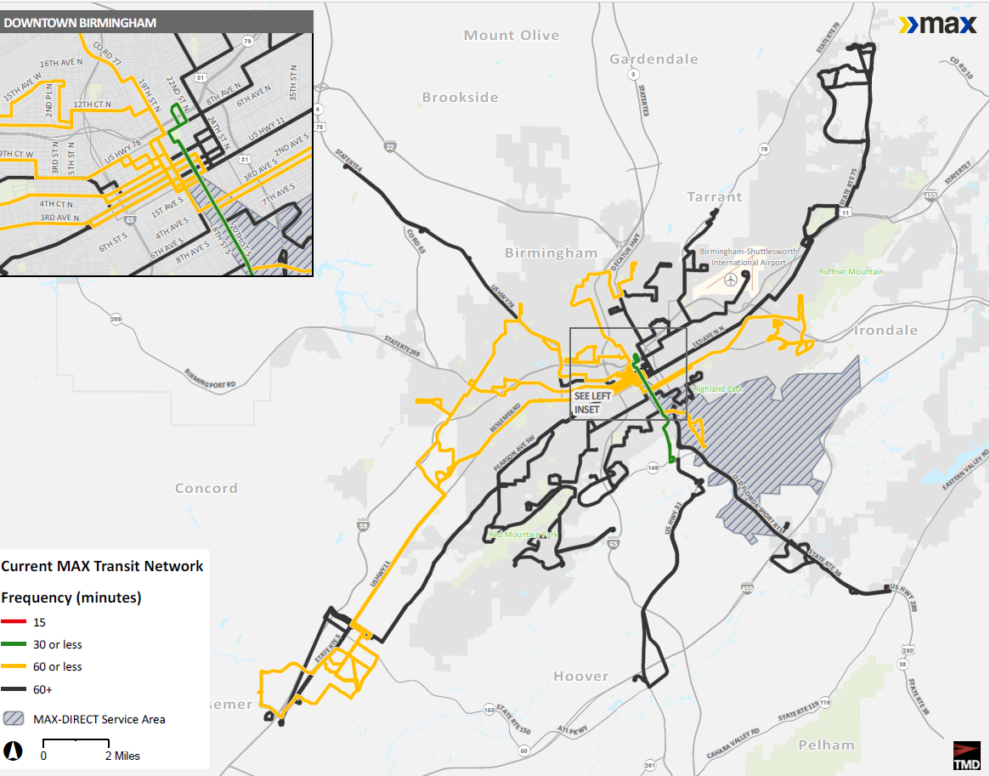
Existing Network
Infrequent
One route operates every 20 minutes (Magic City Connector)
All other routes operate every 40 minutes or more
Multiple route patterns and varying frequencies over the day confuse customers
No Sunday service
Notes:
Just 1 route connects to shift times and school bells.

Slide 13
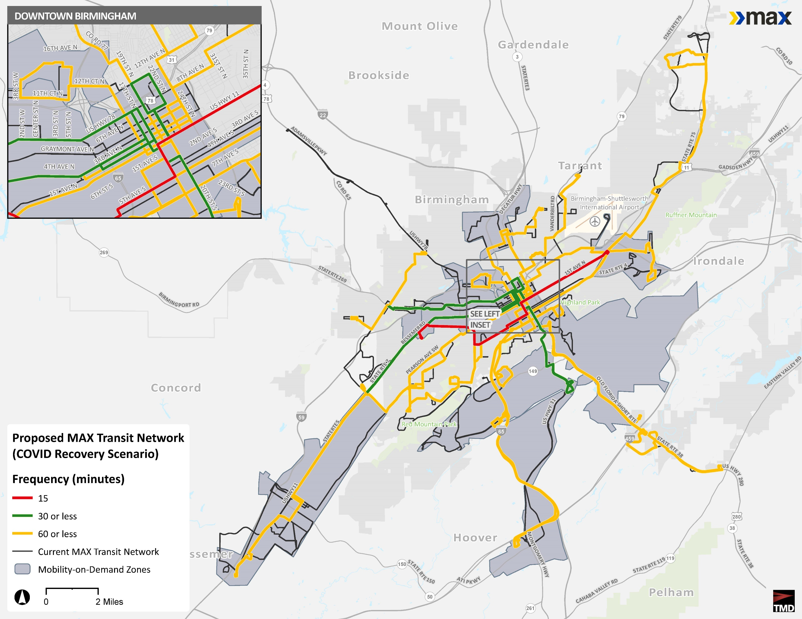
Draft Network Plan – COVID Recovery
Improves frequency: All routes operate every 60 minutes or better
Simplifies routes: one pattern for each route and similar service hours across all routes
Connects with BRT route (15-min)
New On-Demand Microtransit zones
Faster regional connections with mobility hubs

Slide 14
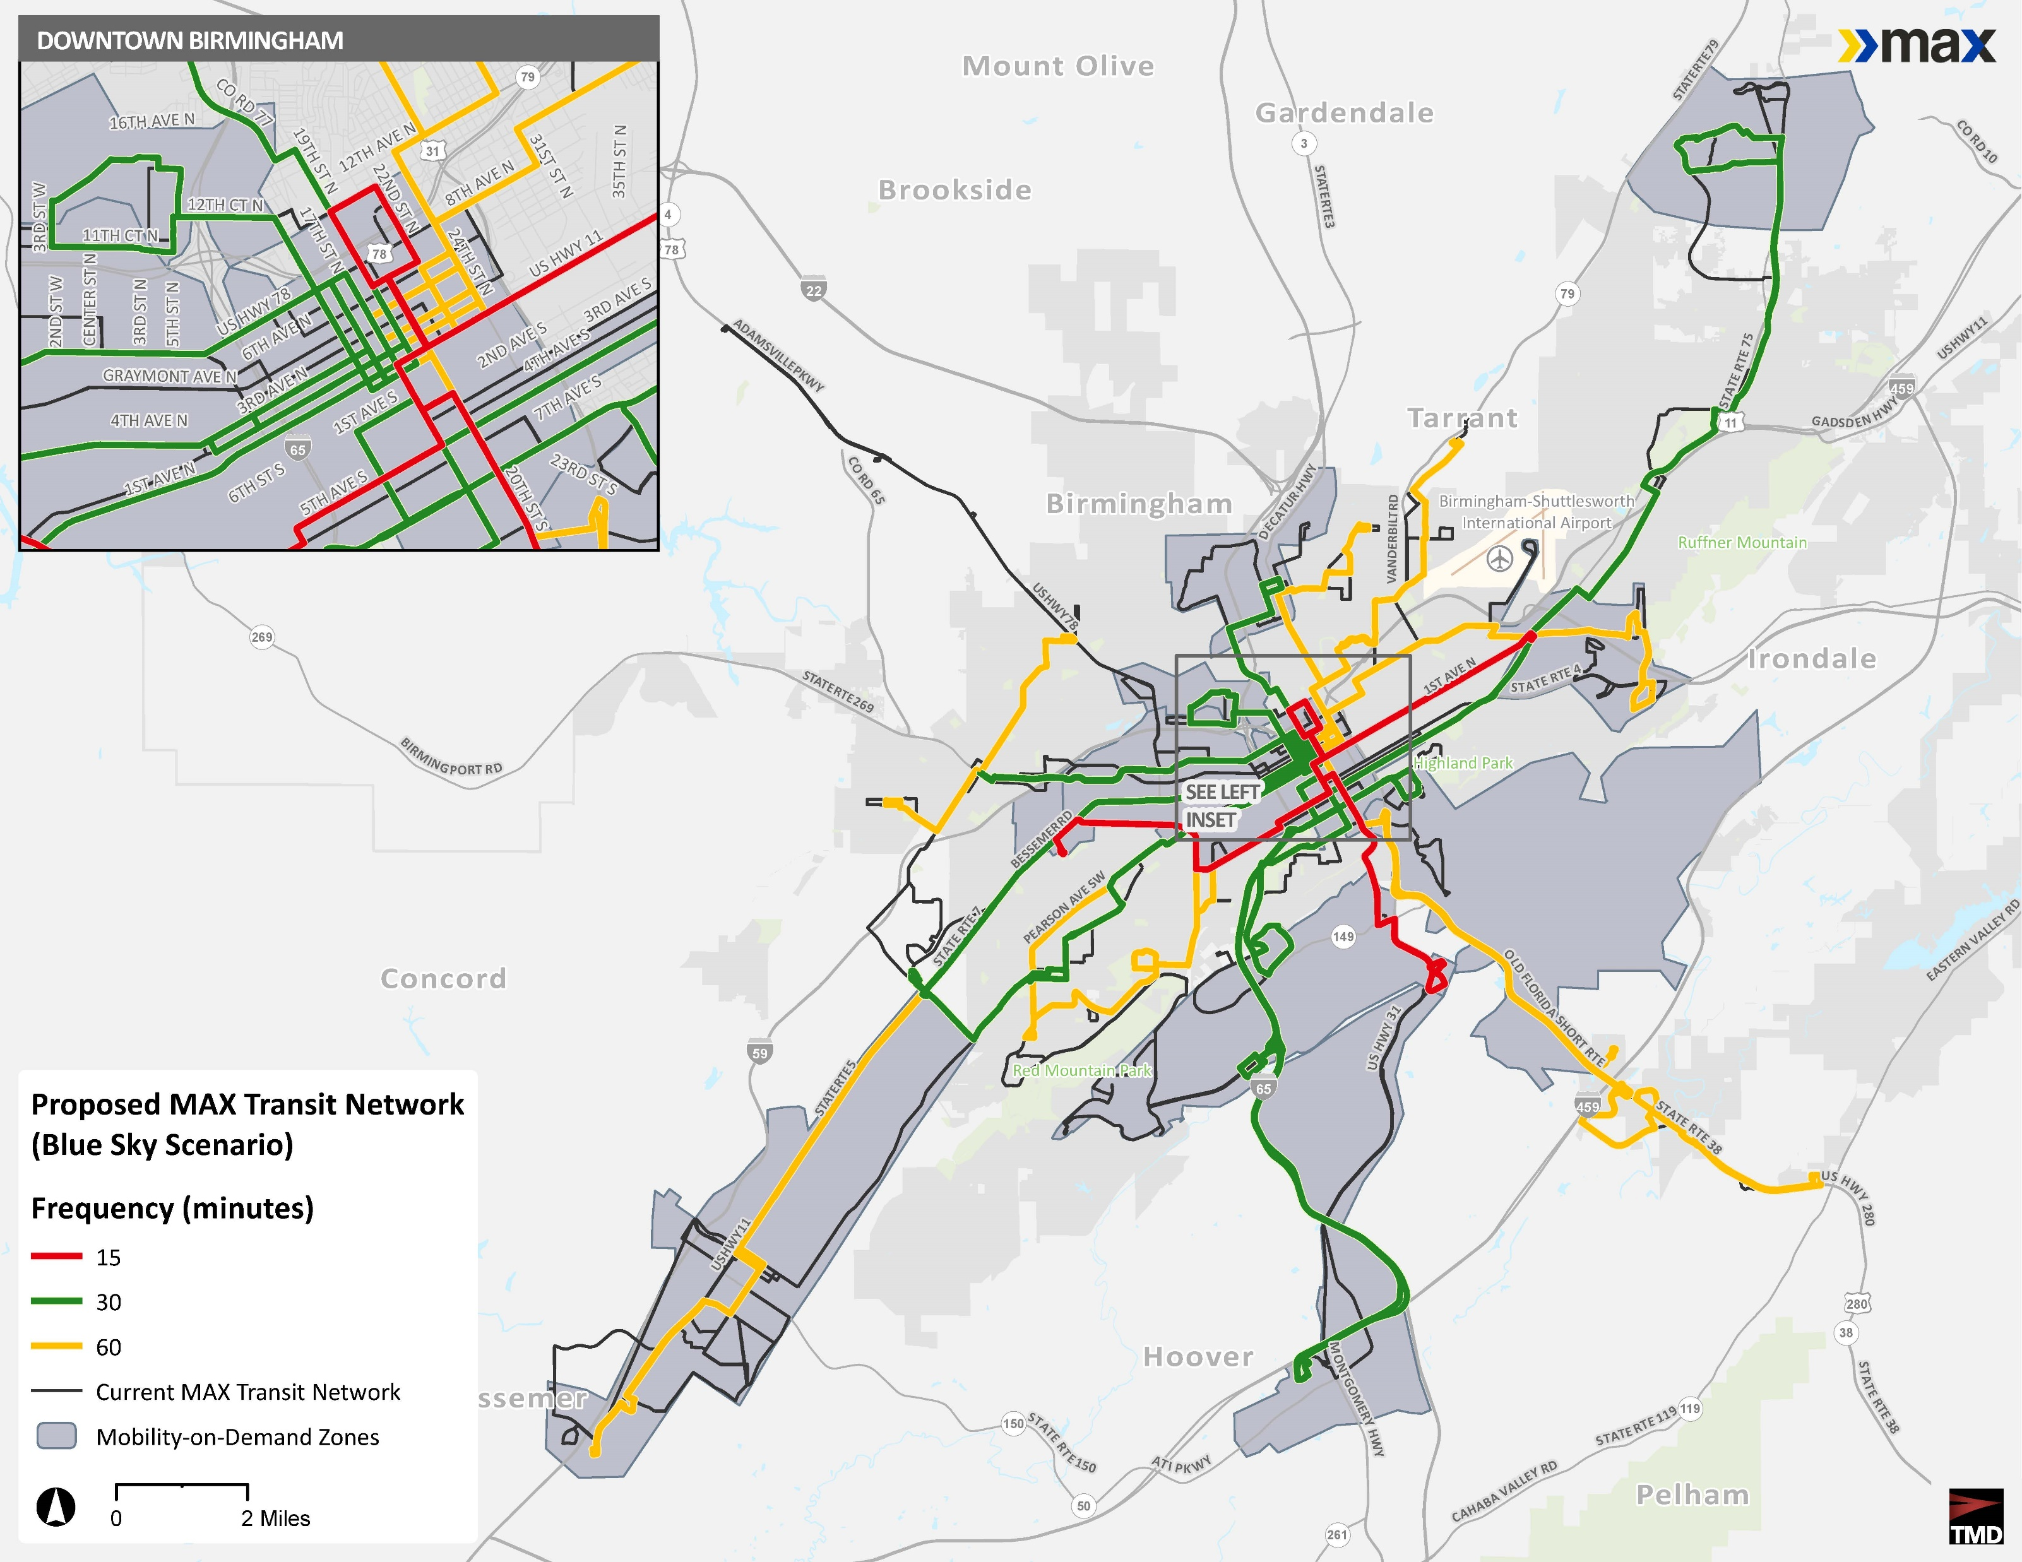
Draft Network Plan – ‘Blue sky’
Improves frequency: Most routes operate every 30 minutes or better
Simplifies routes: one pattern for each route and similar service hours across all routes
Connects with BRT route (15-min)
Adds Sunday Service
More On-Demand Microtransit zones
Faster regional connections with mobility hubs and park-and-rides

Slide 15
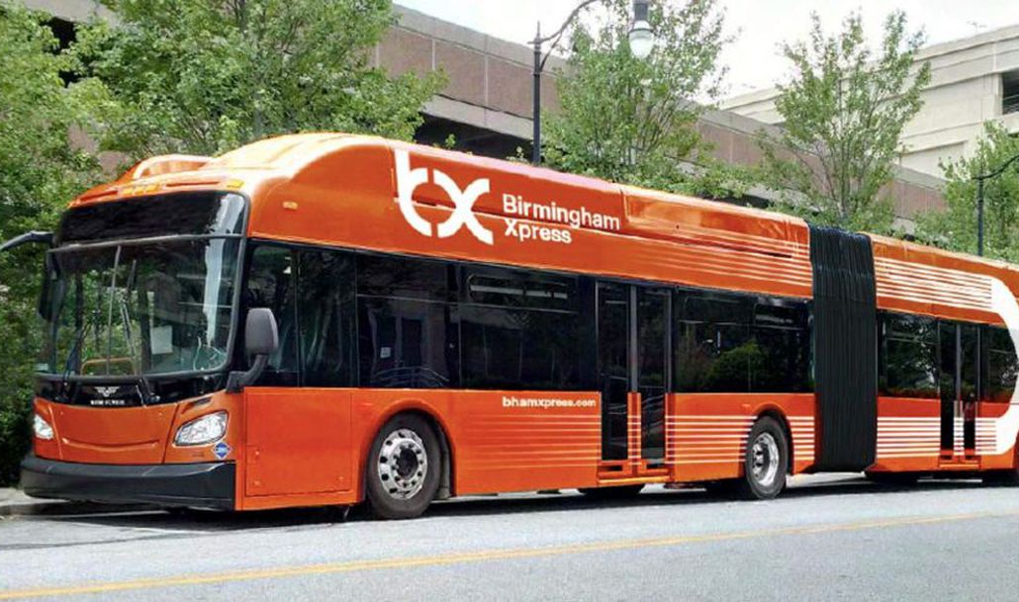
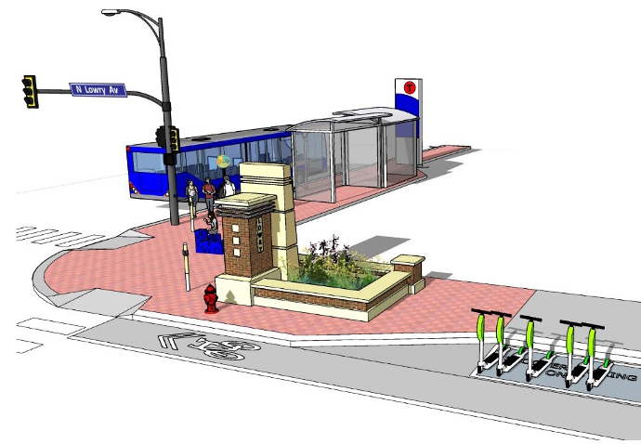
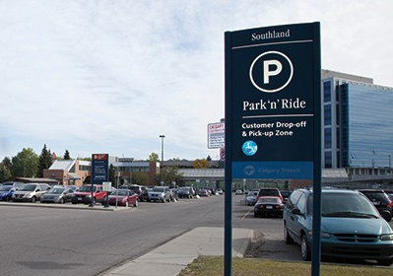
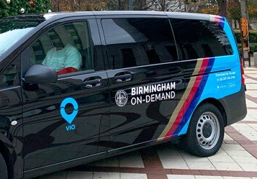
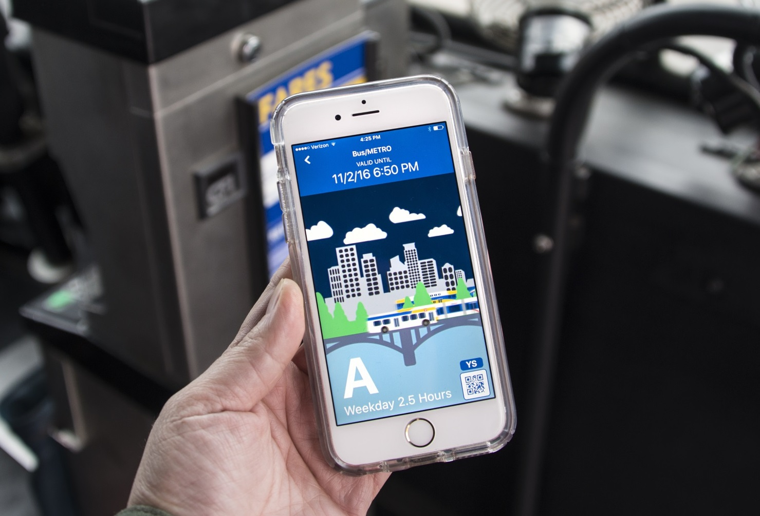
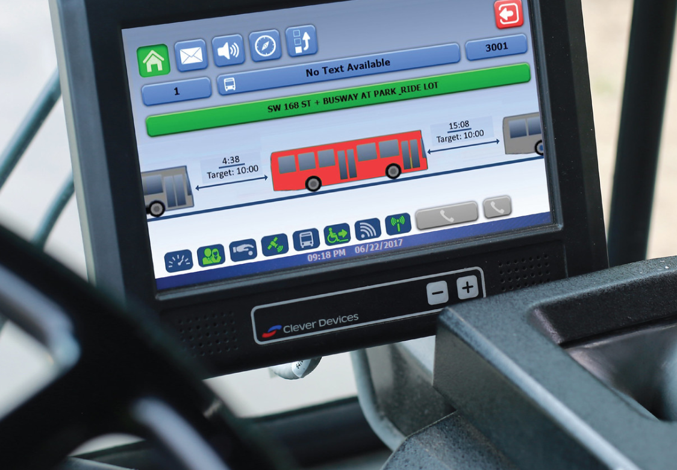
Network Recommendations
Transit Priority on Frequent Corridors
Community Mobility Hubs
Park and Rides
Microtransit/On-Demand
More Reliable Service
New Technology

Slide 16
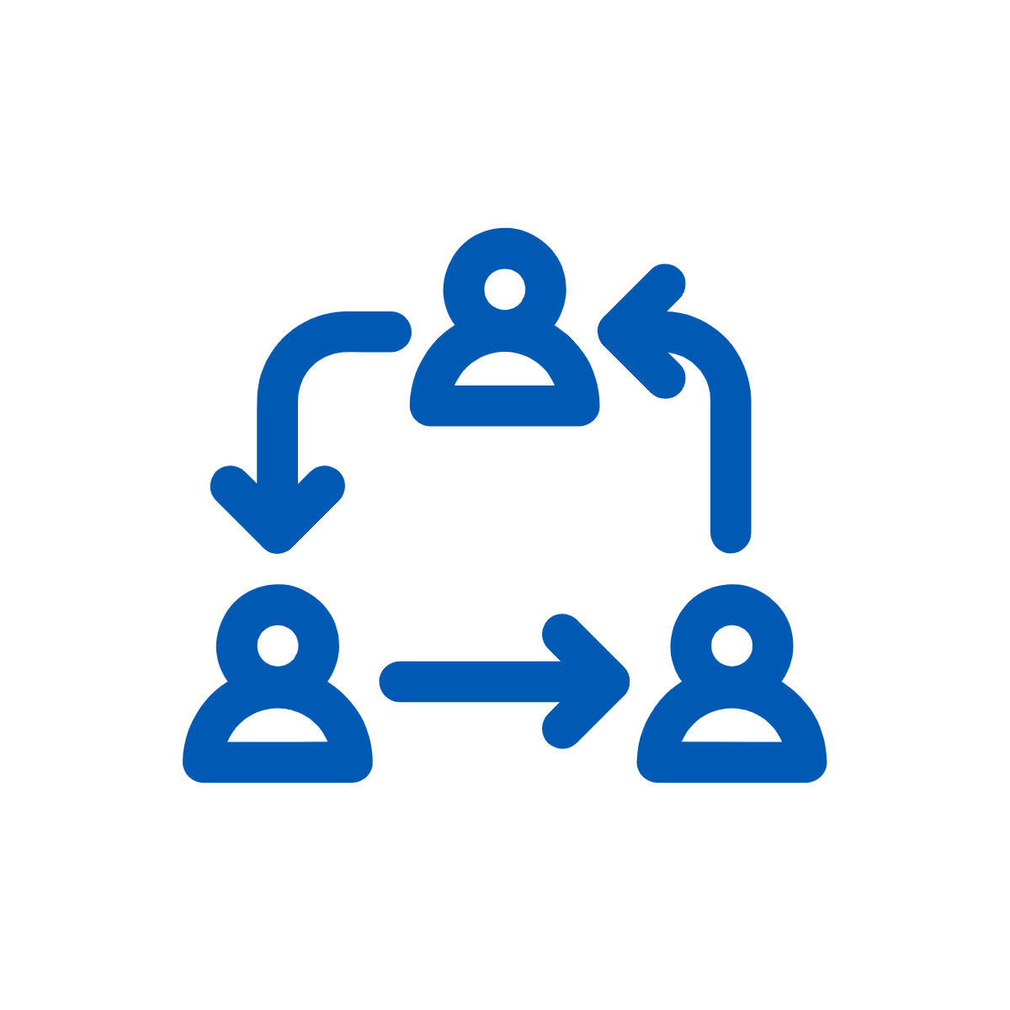
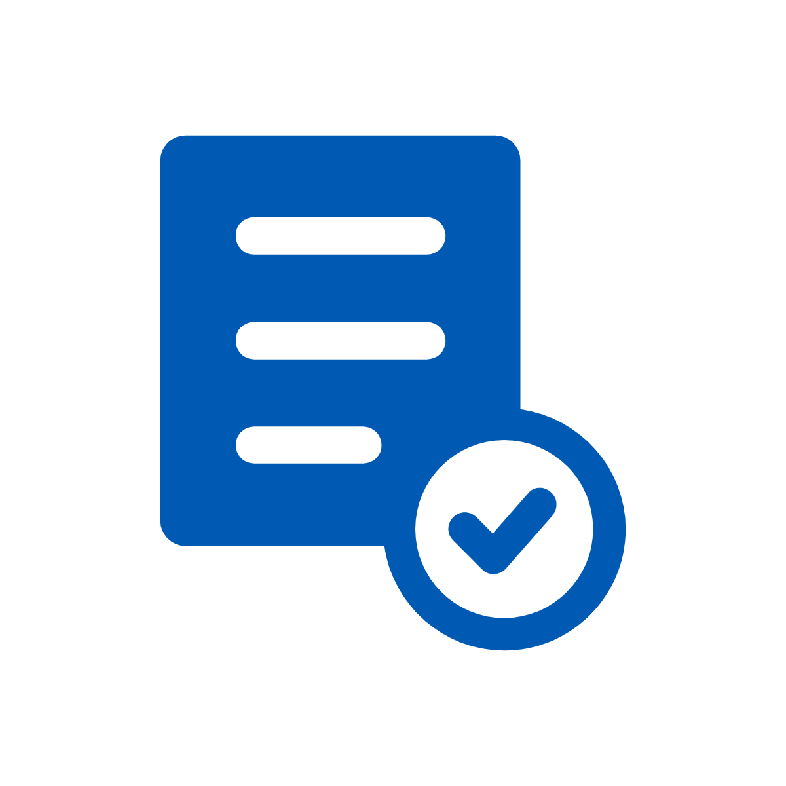
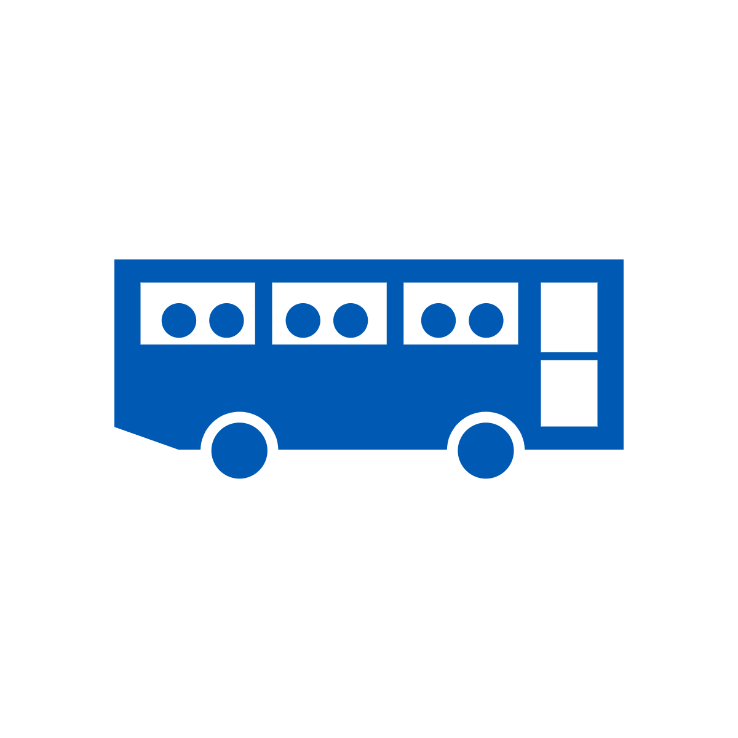
Next Steps
Finalize Draft the Network Plan
Present to Board, Stakeholders, & Public
Finalize Network Plan
Begin Phased Implementation
February-March 2021
March-April 2021
April - May 2021
Early 2022

