Slide 1
MISSION: To spread literacy-rich, community-oriented, enjoyable content to Alabama’s youngest citizens.
SHORT the SQUIRREL
CO-FOUNDERS:
Dee Dupree Bennett, Ed.D.
Monica Anderson Young, Ph.D. candidate

Slide 2
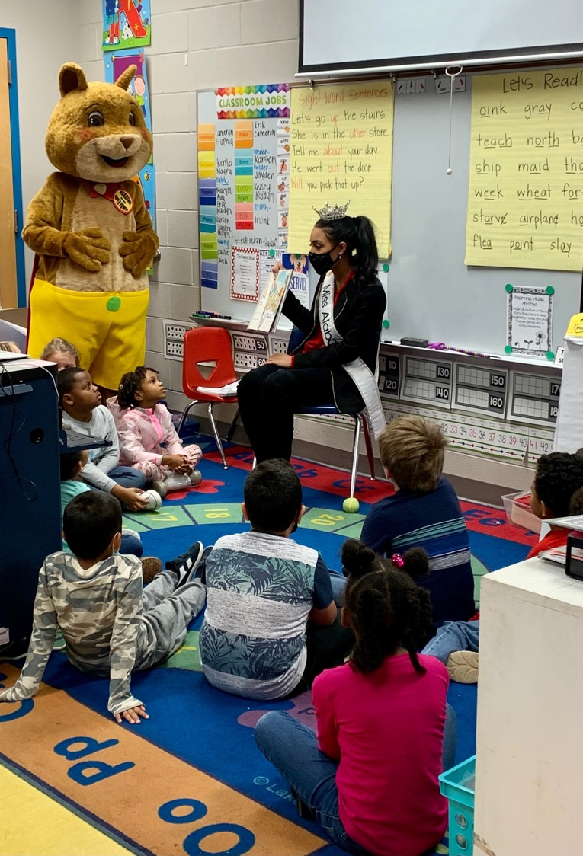
Agenda
Our Journey
SHORT’s tale
The Meaning of SHORT
The One-Year Mark
Happy Birthday, SHORT!
Projects in Flight
Five Point Campaign
What’s Next
Challenges
Opportunities

Slide 3
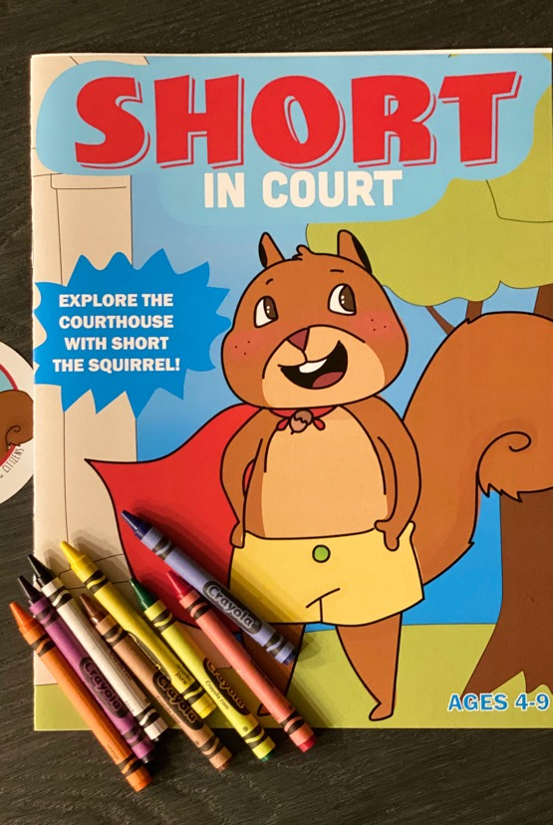
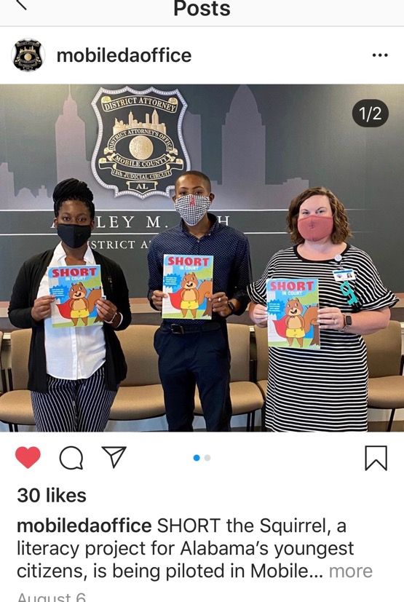
Our Journey

Slide 4
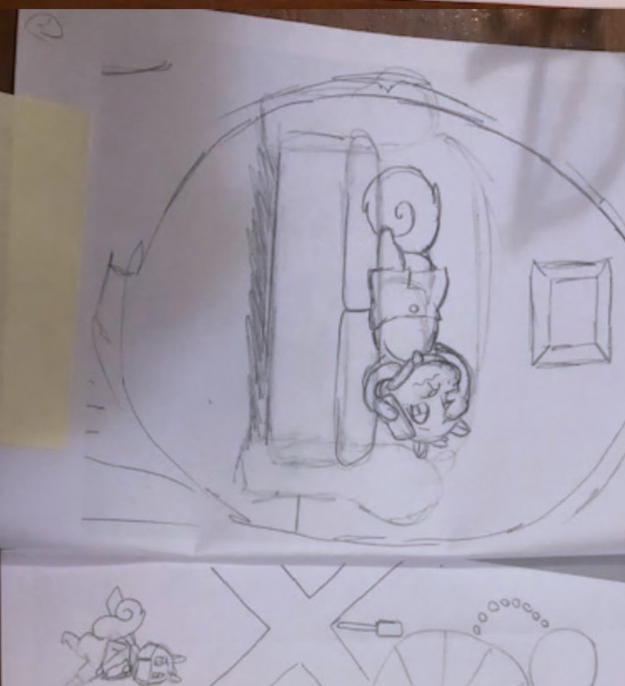
A SHORT History
Observation by Mobile ADA
Partnership with Dee and Monica
Premise: a squirrel with a cape
Research of overwhelming statistics
Identification of “gaps” of time
Illustration shown from SHORT Gets Sick draft

Slide 5
SHORT Timeline
SHORT Expands
SHORT Gets Sick
SHORT Recycles
SHORT’s Feelings
Pilot
Mobile, Pike, Baldwin, Escambia Counties;
Hola, Alabama!
SHORT launches in courtrooms statewide in English and Spanish!
SHORT
Is born
Feb. 2020
Fall 2020
February 22, 2021
Late Summer
2020
1Q 2021
2Q 2021
Prepare to Launch
501 (c) (3)
Establish volunteer team and intern program
SHORT Turns One
First literacy celebration/
Montgomery, AL
Tie in with Alabama Literacy Act

Slide 6
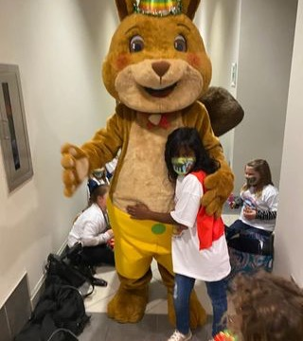
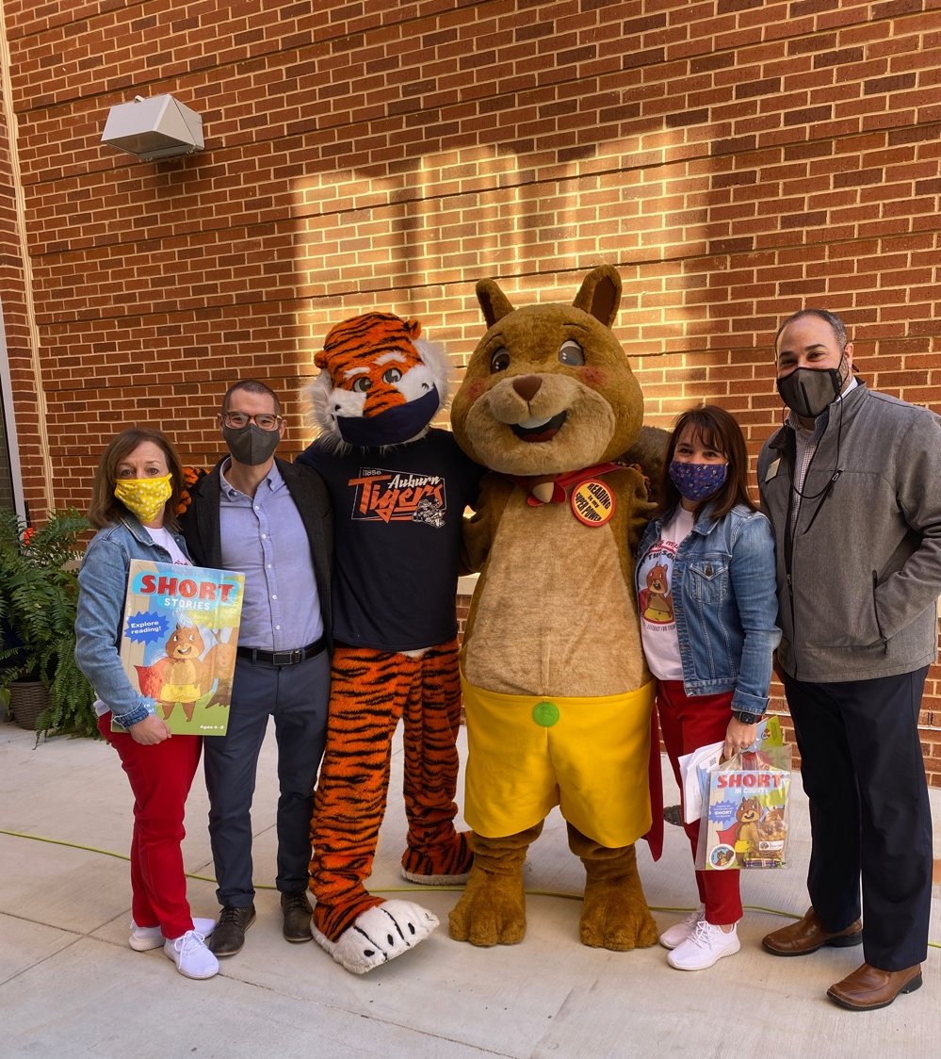
The One-Year Mark

Slide 7
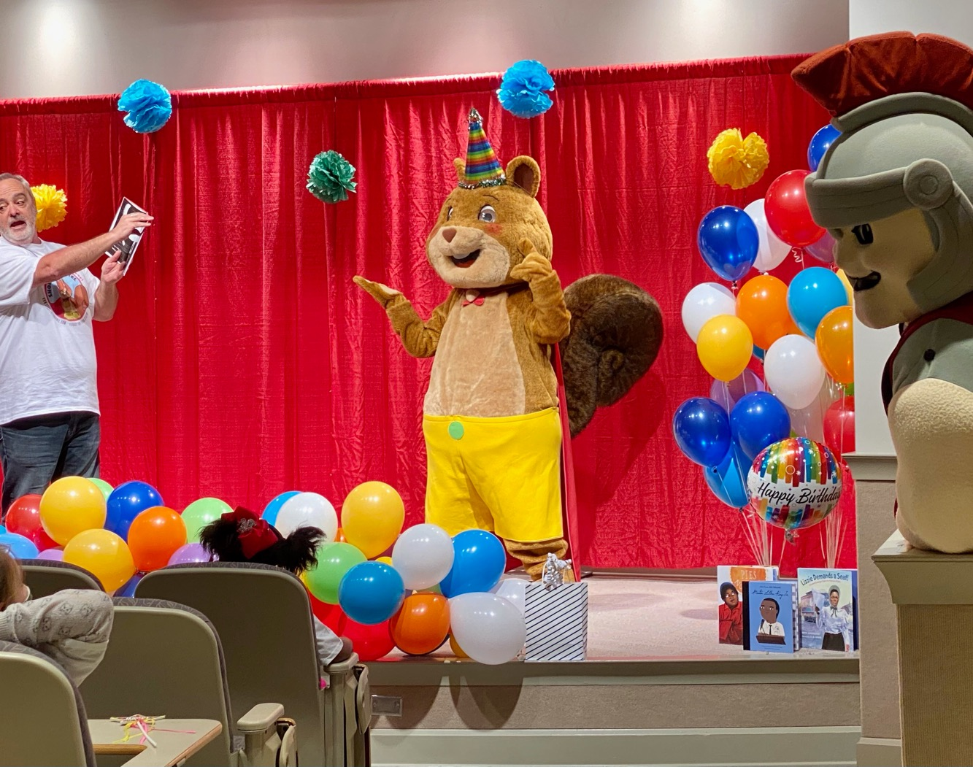
Happy Birthday, SHORT!
Virtual reading pep rally/ birthday party
Purpose – to introduce Alabama children to SHORT
Awareness increases adoption!
SHORT Turns Two - February 22, 2022 – SHORT in Mobile

Slide 8
“Best Day Ever” – Awareness builds Adoption Aubie Meets SHORT

Slide 9
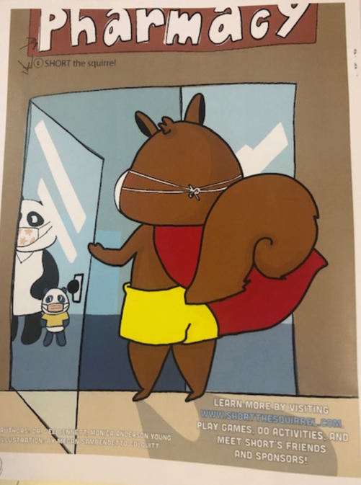
Projects In-Flight
SHORT Gets Sick
Educators overwhelmingly voted for this as the next title.
STATUS – Book almost complete. Looking for pilot funding.
SHORT Can Recycle
Pilot to be released to Pike County first graders.
Funded through recycling grant through Troy University and RCD.
SHORT’s Feelings
Proposed pilot in Montgomery County with DHR.
To be used in conjunction with SHORT in Court and Victim’s Services.
In conjunction with Earth Day.
MARCH 2021
APRIL 2021
2021 PROPOSED

Slide 10
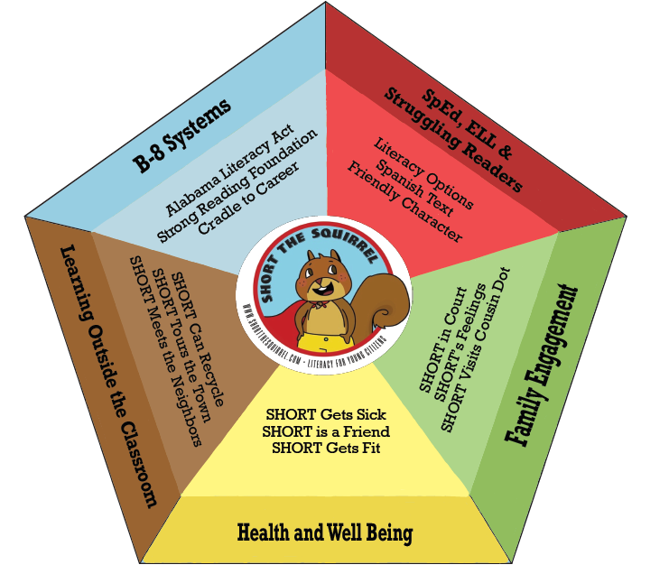
Five Point Campaign
Partnering with:
The Children’s Policy Council
Alabama DA Association
Alabama Law Foundation
Wiregrass Resource Conservation & Development
Montgomery & Pike County Commissioners
Troy Design Center
Alabama Circuit Clerks Association

Slide 11
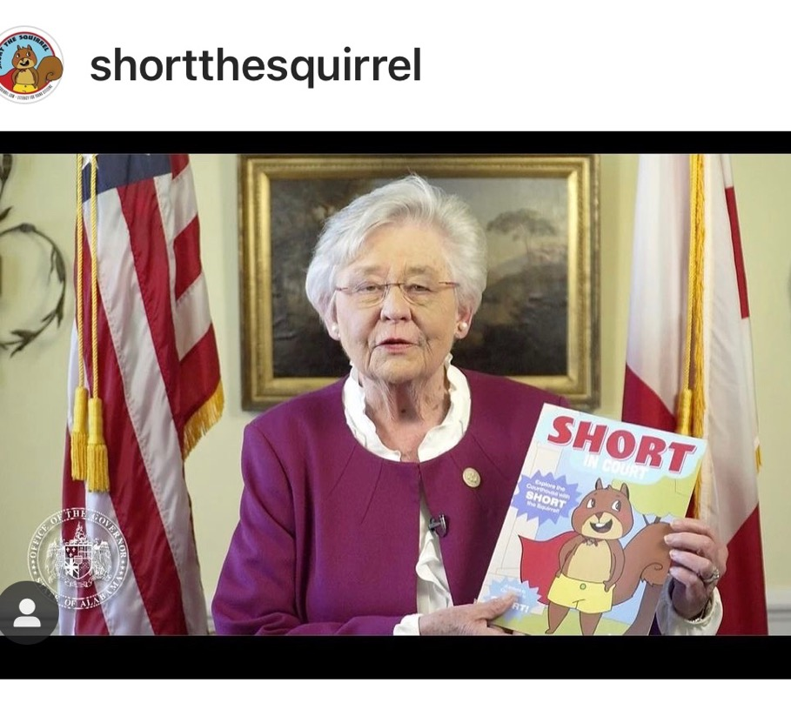
What’s Next

Slide 12
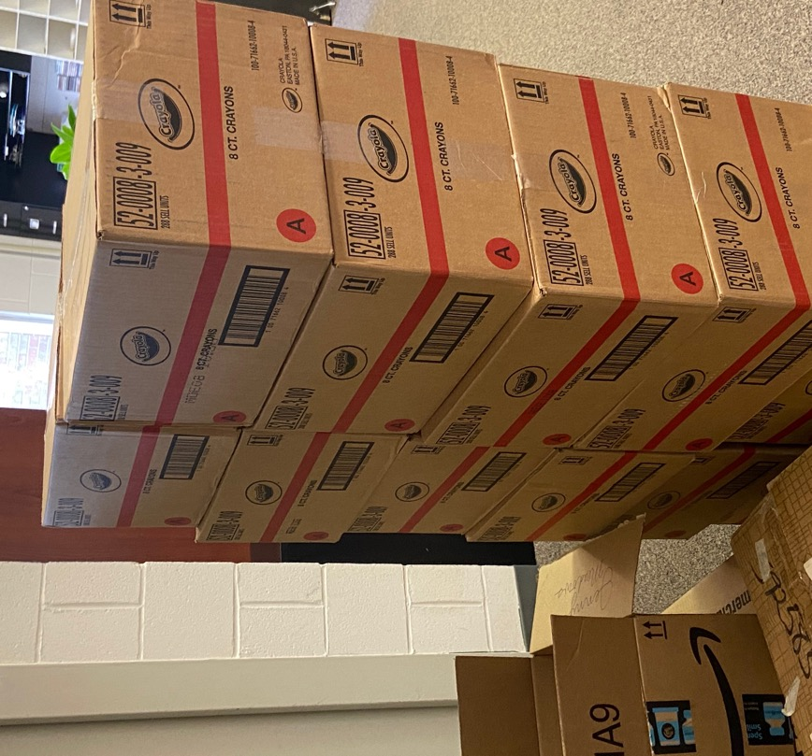
Challenges
7,000
Crayon
boxes!!
Supply Chain
Sustainability
Workforce Strategy

Slide 13
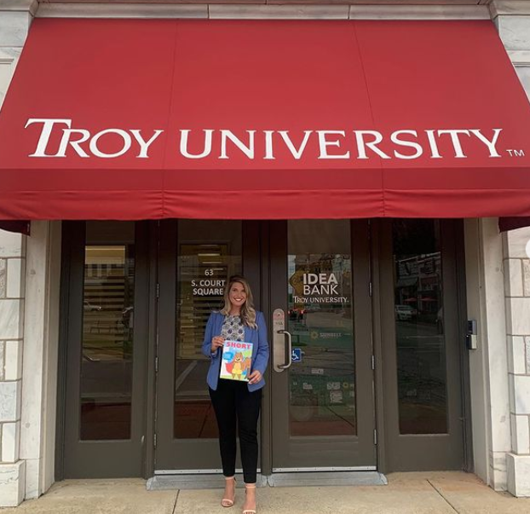
Opportunities
Cradle to Career
Grants

Slide 14
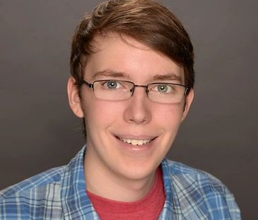
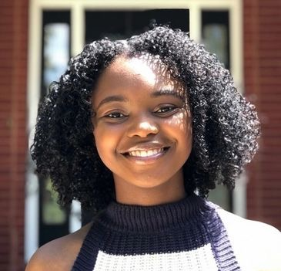
Internship Openings
“My experience working as a Technology Intern for SHORT the Squirrel has been highly beneficial in terms of my professional growth, the doors it has opened, and my appreciation for the mission of spreading literacy among the youth of Alabama.”
- Zak Francis, First SHORT the Squirrel Technology Intern
Technology Support Intern
Social Media Intern
SHORT the Squirrel has provided me with amazing opportunities and networking connections all while working to further education in the state of Alabama.
--Jordan Sampson, First SHORT the Squirrel Social Media Intern

Slide 15
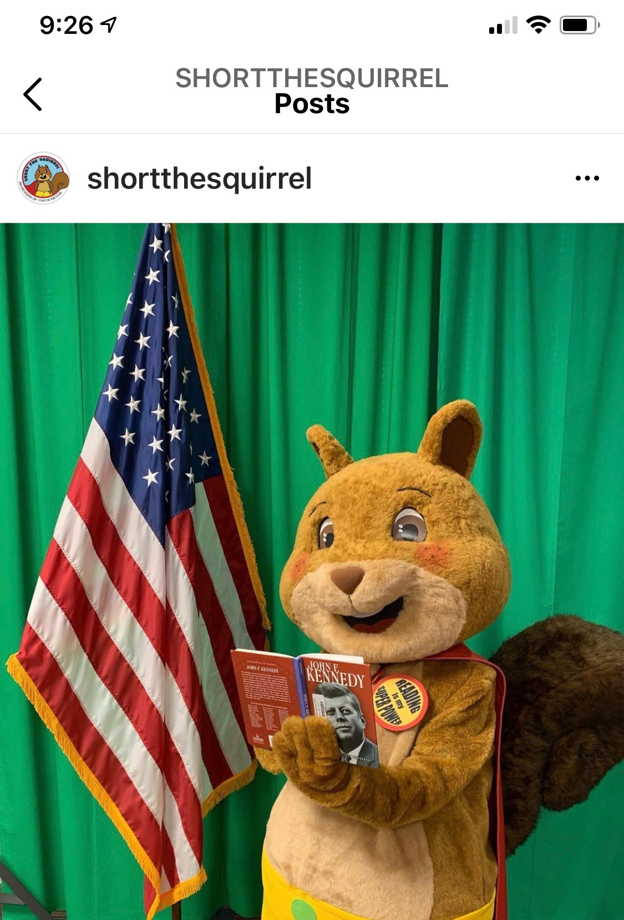
Call to Action
Follow us on social media!
Reach out to area educators.
Partnership opportunities.
Consider supporting SHORT the Squirrel.

Slide 16
Please visit https://SHORTtheSquirrel.com
monicaandersonyoung@gmail.com dmdbennett@gmail.com

