Slide 1
The City of Birmingham, Alabama
Pension Recap

Slide 3
Pension Funded Level
According to the Government Finance Officers Association (GFOA) in their Best Practice, “Sustainable Funding Practices of Defined Benefit Pension Plans”, municipalities’ public pension plans should target a 100% funded ratio.

Slide 4
Net Pension Liability
2019

Slide 5
Debt Outstanding
Bonds, Warrants and Leases

Slide 6
Total Indebtedness
Bonds, Warrants, Pension, OPEB and Compensated Absences

Slide 7
City’s Credit Rating – Fitch
Fitch Downgrades Birmingham

Slide 8
Brief History of the Retirement and Relief System Funding

Slide 9
Pension Funding
Brief History of Retirement & Relief System Funding
Since FY2004, the total contributions have been less than the required amount. Shortfall was mostly the result of investment returns lower than assumed.
Since 2017:
City Contribution Rate has doubled from 7.0% to 14.5%
Employee Contribution Rate has stayed flat at 7.0%
23.1%
21.5%
12.9%
6.5%
67%
6.5%
6.5%
7.0%
7.0%
7.25%
8.5%
12.0%
14.5%
33%
6.5%
6.5%
7.0%
7.0%
7.0%
7.0%
7.0%
7.0%
Note: Graph shows Fiscal Year ending June 30. The required rate is based on a rolling 30-year amortization as a level % of pay. FY2021 shows proposed budget.

Slide 10
City Contribution Rates

Slide 11
$14 Million Increase since 2017

Slide 12
Pension Funding vs. Contribution Rates
As of 2019, except where noted

Slide 13
Employee Pension Contributions
As of 2019
Source 2019 CAFRs.

Slide 14
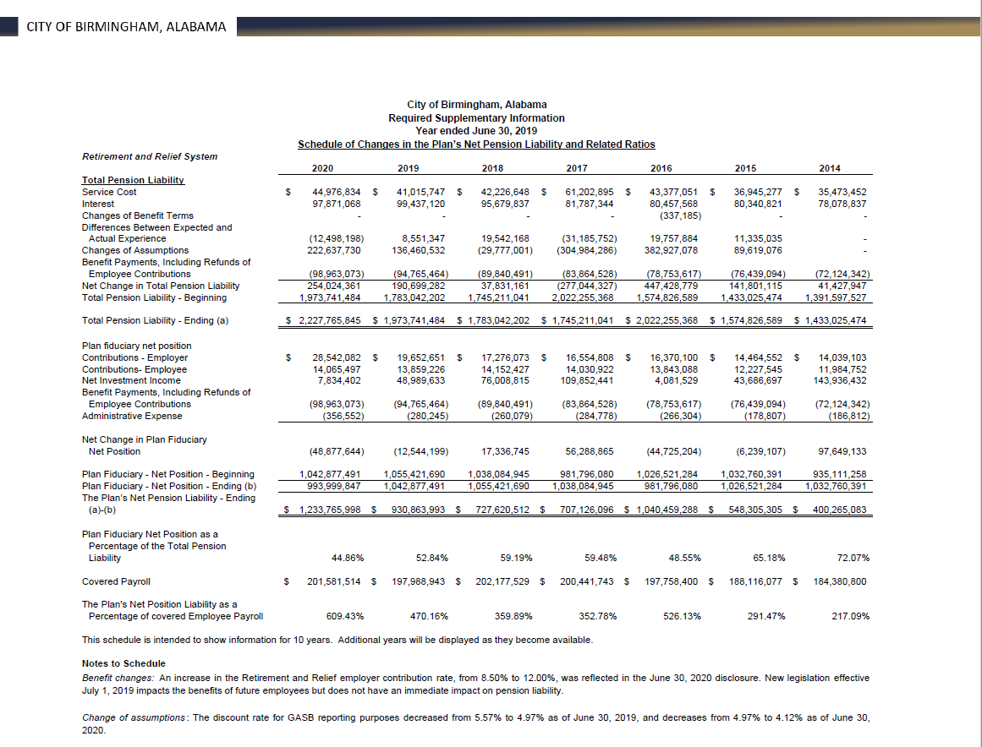
Changes in Plan Assets

Slide 15
City of Birmingham, Alabama
Required Supplementary Information
Year ended June 30, 2020
Schedule of the Employer's Contributions
 | Retirement and Relief System
 |  |  | 2020 | 2019 | 2018 | 2017 | 2016 | 2015 | 2014
 | Actuarially Determined Contributions |  | $32,151,230 | $31,146,931 | $30,063,990 | $30,564,212 | $29,898,918 | $30,398,187 | $30,553,712
 | Contributions in Relation to the
 | Actuarially Determined Contributions |  | 28,550,642 | 19,652,651 | 17,276,073 | 16,554,808 | 16,370,100 | 14,464,552 | 14,039,103
 | Contribution Deficiency (Excess) |  | 3,600,588 | 11,494,280 | 12,787,917 | 14,009,404 | 13,528,818 | 15,933,635 | 16,514,609
 | Covered Payroll |  | 201,581,514 | 197,988,943 | 202,117,529 | 200,441,743 | 197,758,400 | 188,116,077 | 184,380,800
 | Contributions as a Percentage of
 | Covered Payroll |  | 14.16% | 9.93% | 8.55% | 8.26% | 8.28% | 7.69% | 7.61%

Slide 16
Net Pension Liability for June 2019 Financial Reporting
The System is required to provide disclosures under GASB Statements 67 and 68. The net pension liability (NPL) required to be reported by GASB differs in methodology and assumptions from the UAL reported in the funding valuation. The NPL is also based on the market value of assets, whereas the UAL is based on the smoothed actuarial value of assets.
The System is required to use a blended interest rate for GASB purposes, because an insolvency is projected when the contributions assigned to cover the normal cost of future entrants are excluded. The interest rate used in the June 30, 2019 disclosures was a blend of the 7.50% funding rate and a 3.50% 20-year municipal bond rate, and was equal to 4.97%.
Had the 12% City contribution rate been in effect when the June 30, 2019 disclosures were prepared, the blended rate would have been 5.72%, and the NPL would have been $763 million.
 | Funding Basis | GASB 67/68 Basis (4.97%) | GASB 67/68 Basis if City Contributes the ADC (7.50%)
Liability | $1.501 billion | $1.974 billion | $1.487 billion
Assets | $1.064 billion | $1.043 billion | $1.043 billion
Unfunded Liability | $437 million | $931 million | $444 million

Slide 20
Pension Funding
2021 Budget
Increasing pension funding to 14.5% in 2021 budget
~90% of expected actuarily determined contribution rate
Brings amortization period from infinite to ~75 years
16.1% funding brings amortization down to ~40 years
16.1%
Notes:
Proposed to the pension board to vote effective changes to close the gap – voted 4-4. Special meeting at end of September. Believe that they have enough votes to present at the February legislative session. Might be 0.2%. When you fund 100% of ADC, you would use the 7.5% discount rate for everything instead of blended rate.
Moody’s looks at this as debt. At 14.5% on 75-year amortization, closing to 16% brings it down to 40 years.
Mayor attends every pension board meeting.
By fully funding the pension, the city no longer has to devote liquidity to fund it even more in the future.

Slide 21
Snapshot Results of 2019 Actuarial Valuation
Based on July 1, 2019 actuarial valuation, total contribution requirement is 23.06% of pay; City’s actuarially determined contribution (ADC) is 16.06% of pay, which is net of the 7.00% employee rate
ADC equals normal cost net of employee contributions (for benefits accruing in the current year) plus a 30-year level percent amortization of the unfunded actuarial accrued liability (UAL)
Based on the current 12.00% rate, there is a deficit of 4.06% of pay
Deficit is large enough that the UAL is not being amortized
If all actuarial assumptions are met, the UAL will continue to grow, the funded percentage will drop, and the recommended contribution will increase
In the prior valuation, the ADC was 14.96% of pay
System experienced a $13.2M loss in the 2018-2019 fiscal year due to contributions being less than the ADC
Also experienced $18.3M loss due to investment return for FYE 2019 (Investment return of 4.78% on market; return on actuarial value was 5.74%)
Net gains from other sources were $1.9M, equivalent to 0.1% of liability
The net losses are the primary reason for the 1.10% of pay increase in ADC from 2018 to 2019

Slide 22
City Contribution Rates

Slide 24
End of Presentation
Thank
You

Slide 25
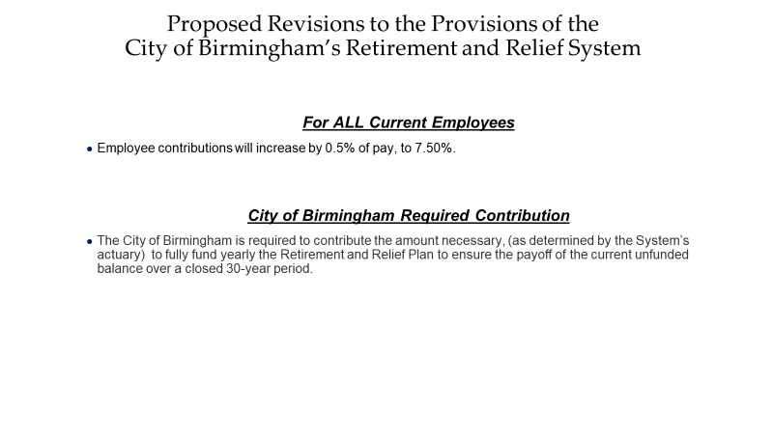

Slide 26
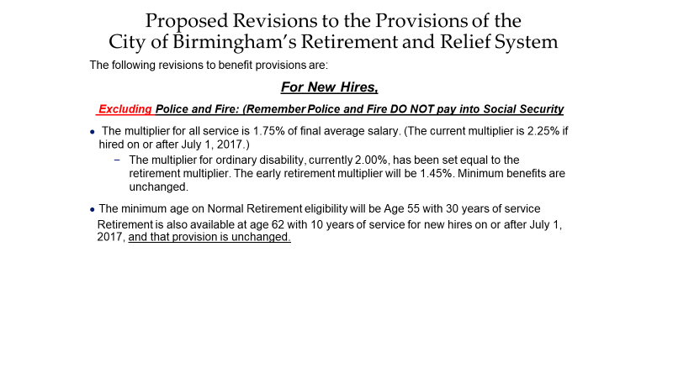

Slide 27
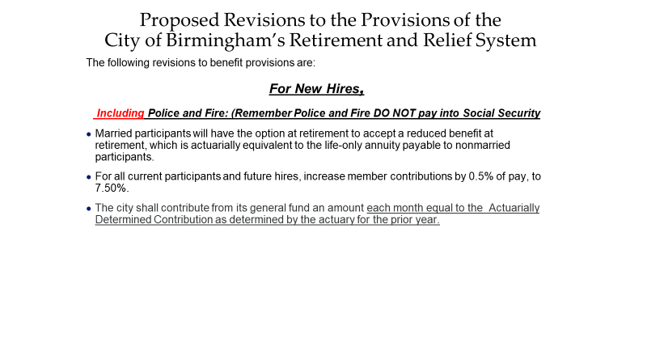

Slide 28
Schedule of Employers Contributions
City of Birmingham, Alabama
Required Supplementary Information
Year ended June 30, 2020
Schedule of the Employer's Contributions
 | Retirement and Relief System
 |  |  | 2020 | 2019 | 2018 | 2017 | 2016 | 2015 | 2014
 | Actuarially Determined Contributions |  | $32,151,230 | $31,146,931 | $30,063,990 | $30,564,212 | $29,898,918 | $30,398,187 | $30,553,712
 | Contributions in Relation to the
 | Actuarially Determined Contributions |  | 28,550,642 | 19,652,651 | 17,276,073 | 16,554,808 | 16,370,100 | 14,464,552 | 14,039,103
 | Contribution Deficiency (Excess) |  | 3,600,588 | 11,494,280 | 12,787,917 | 14,009,404 | 13,528,818 | 15,933,635 | 16,514,609
 | Covered Payroll |  | 201,581,514 | 197,988,943 | 202,117,529 | 200,441,743 | 197,758,400 | 188,116,077 | 184,380,800
 | Contributions as a Percentage of
 | Covered Payroll |  | 14.16% | 9.93% | 8.55% | 8.26% | 8.28% | 7.69% | 7.61%

