Slide 1
Need a Ride? Find a Ride!
Redefining Carpool. In Community.

Slide 2
Agenda
1.
2.
3.
4.
Why Are They Here?
Coolbus Overview
Demo
“Do Good” Model
We know you’re asking, so we will answer (hopefully)!
Short and sweet
To show how the product works
Explain our approach to supporting the community
Need a Ride? Find a Ride!

Slide 3
Why Am I Here?
“80% of success is just showing up.”
—Woody Allen
“Every resource you need is found in a relationship.”
—Lee Domingue
Why Is Coolbus Here?
Increase Access
Reduce Absenteeism
Support Families & Communities
Gain understanding of Coolbus
Explore collaboration between The City and Coolbus
Need a Ride? Find a Ride!

Slide 4
What is Coolbus?
mobile application
connecting parents with other parents (or grandparents, coaches, babysitters, friends)
address the challenges of child transportation.
Coolbus aids parents in:
identifying overlapping, trusted relationships
in their community
going to the same places they are going
And an easy way to communicate
Coolbus is not…
Rideshare for kids (aka Uber for kids)
Randoms picking up kids for cash
Need a Ride? Find a Ride!

Slide 5
Demo
Need a Ride? Find a Ride!

Slide 6
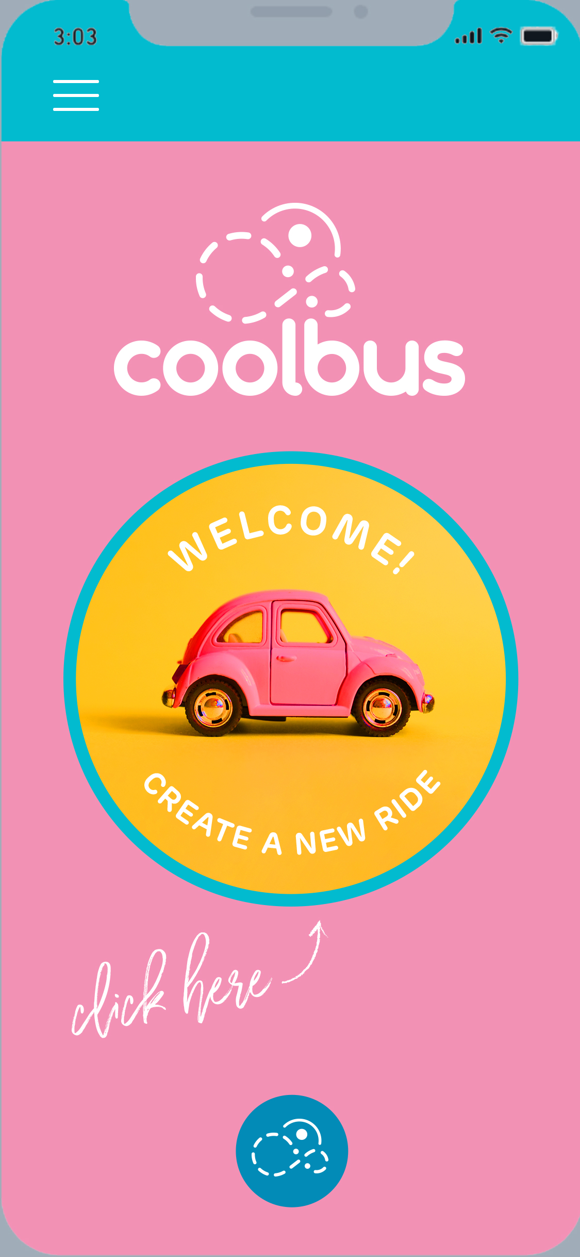
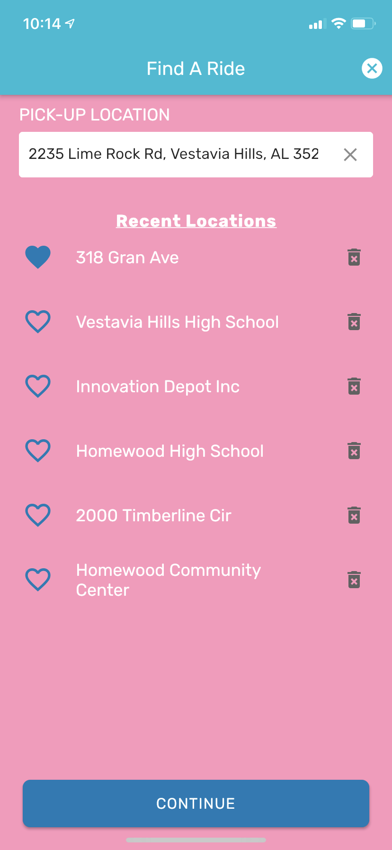
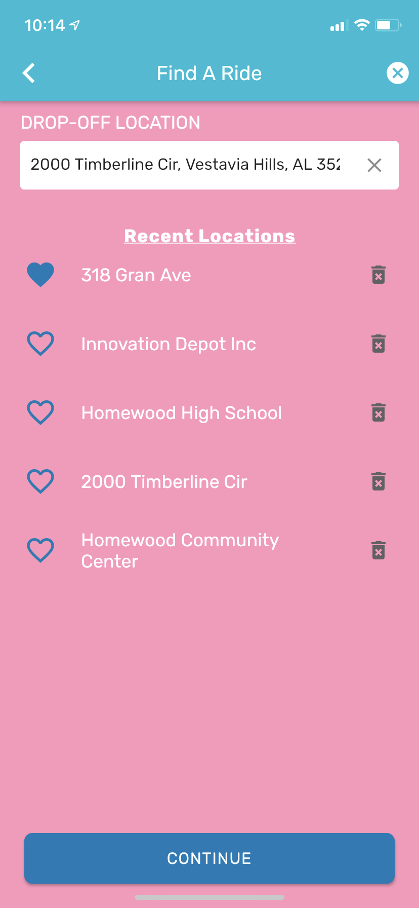
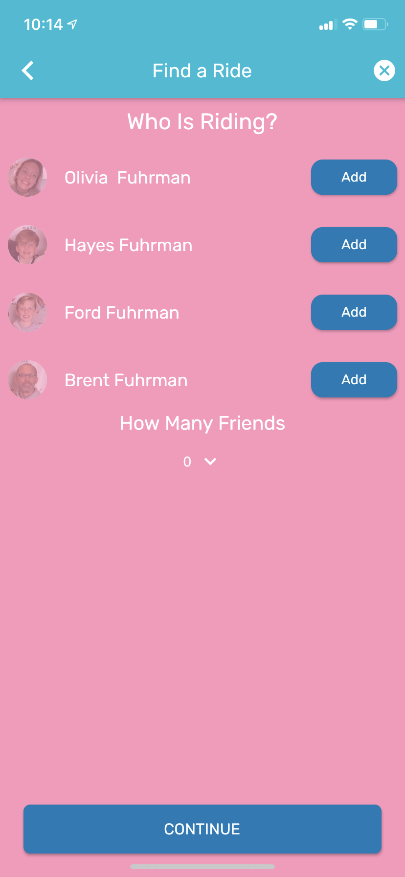
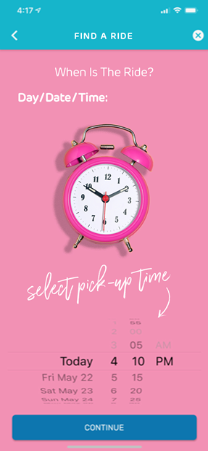
Find A Ride
Everything begins here!
Set Pick-up Location
Set Drop-Off Location
Select Rider(s)
Select
Date & Time
Need a Ride? Find a Ride!

Slide 7
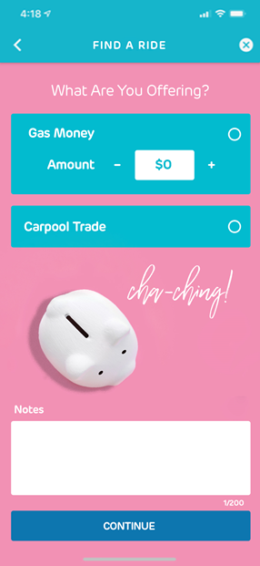
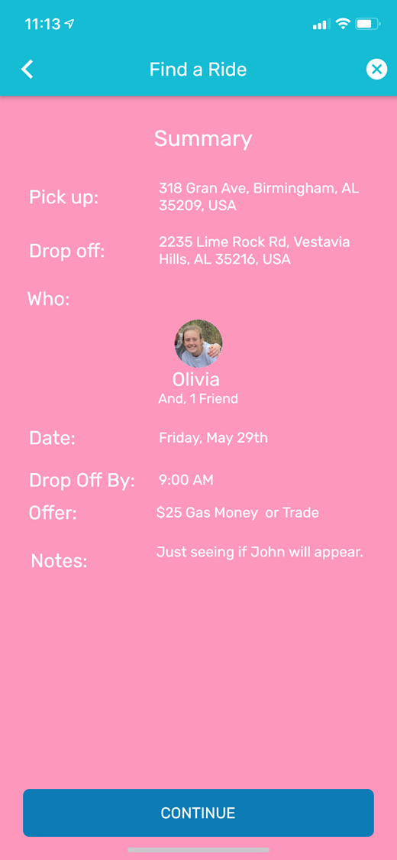
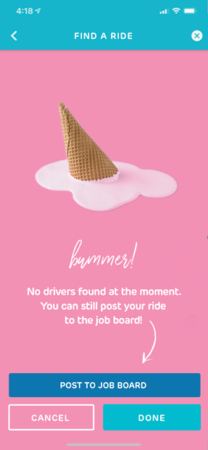
Find A Ride (cont.)
We suggest folks that might overlap with you!
# Trusted Connections - overlapping trusted Coolbus users with me
# Contacts - overlapping phone contacts with me
[star rating] – ratings from other Coolbus
Set Your Offer
Confirm The Details
When no one is found…
That’s It!!
Safe
Simple
Reliable
Relational
Need a Ride? Find a Ride!

Slide 8
Need a Ride? Find a Ride!
Thank You!

