Slide 1
Welcome to our Village!

Slide 2
Legacy Prep is blazing the trail as Birmingham’s first public charter school. We are a purposeful community that sparks love, pride and belonging into the core of who our scholars are and who they are growing to be.
What is Legacy Prep
Growth Plan:
Legacy Prep PreK-8
Legacy Prep High School
Legacy Schools

Slide 3
OUR MISSION is to educate and empower our scholars to embrace their identity, lead lives of choice and opportunity, and impact their communities as the next generation of socially-conscious leaders.
WE ENVISION an exceptional educational experience in our scholars’ lives that readies them to establish their legacy, prepared and inspired to create a life full of opportunity, choice, connection and meaning.
Our Purpose

Slide 4
Legacy Prep Core Values
Measuring Student Success
Bold
Perseverance
Love
Wonder
Excellence
Notes:
Non-academic:
Habits of Success (Modeled after the Building Blocks for Learning Framework) Students will have the following habits of success:
1. Healthy Development (Attachment, Stress Management, Self-Regulation);
2. School Readiness (Self-Awareness, Social Awareness/Relationship Skills, Executive Functions);
3. Mindsets for Self and School (Growth Mindset, Self-Efficacy, Sense of Belonging, Relevance of School);
4. Perseverance (Resilience, Agency, Academic Tenacity); and
5. Independence and Sustainability (Self-Direction, Curiosity, Civic Identity).

Slide 5
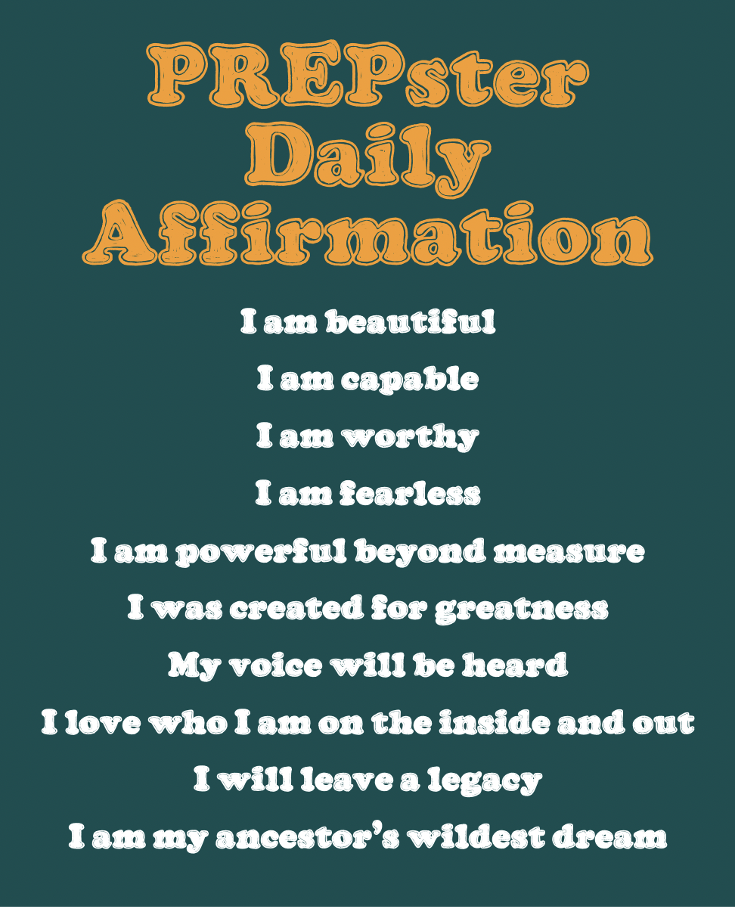

Slide 6
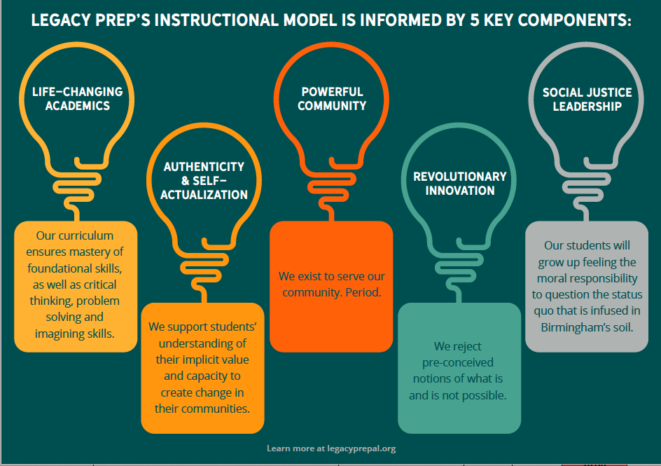
Core Education Design Pillars
Reimagining the Student Experience

Slide 7
How does it look different?
Exploratory Arts are essential pieces of our curriculum. We ensure all scholars have access to Art, PE, Dance, Martial Arts, and Innovation Lab on a weekly basis.
Notes:
HH

Slide 8
How does it look different?
Social-Emotional Learning takes place weekly.
Notes:
JG to present

Slide 9
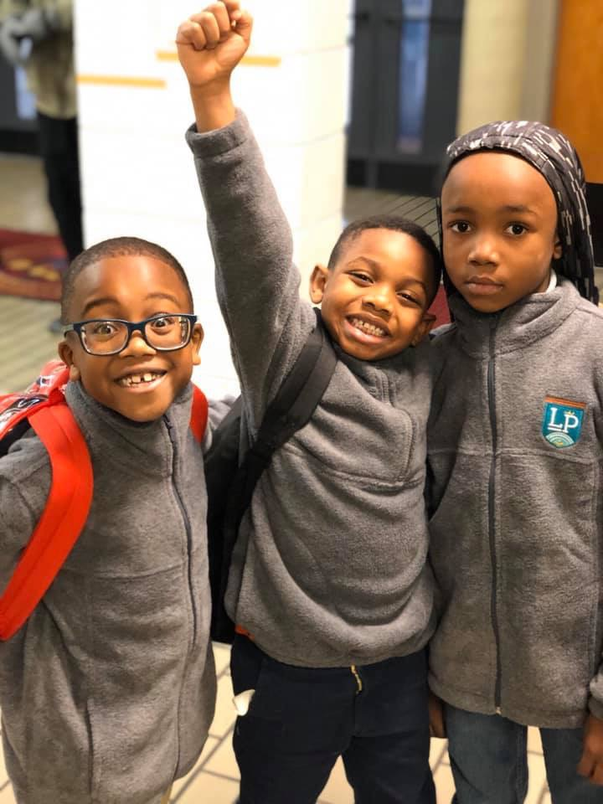
As a school, 89% of our PREPsters showed growth on the MAP Reading assessment
As a school, 94% of our PREPsters showed growth on the MAP Math assessment
96% student retention rate
95% staff retention rate
Average Daily Attendance rate of 94%
Data Snapshot
Notes:
We have capacity to increase to 60 students per grade level. We currently have 60 Kindergarten students enrolled.
The current line of thinking regarding Pre-K is to partner with a high-quality Pre-K provider, utilizing a shared campus. The partnership will begin in the 2020-21 academic year. Thus, Pre-K is not a part of our enrollment projections. Pre-K will be on site at our facility.
Discuss 160+ acres of land

Slide 10
Parents & Families Quotes
What do you like best about our school?
“I absolutely LOVE the way they everyone loves our babies. There isn't a single guide that doesn't know every prepsters name. I love the unique way that you all teach each child based on their individual need. I love how informed that you all keep the parents. I love LEGACY PREP.”
“Teachers love the kids like they are their own.”
Stakeholder Satisfaction

Slide 11
Parents & Families Quotes
What do you like best about our school?
“I like that my son finally loves school.”
"The drive to be the best. The awareness and focus on mental health. The acceptance and support of the liveliness of children. Not dismissing children misbehaving as "bad", but instead exploring what needs they have that may not be being fully met. The push for community development and helping families with basic necessities when possible. The STEAM focus. The monthly field trips. The affirmations. The focus on exposure to a variety of cultures.”
Stakeholder Satisfaction
Notes:
\

