Slide 1
Housing Update
May 16, 2023

Slide 2
MISSION STATEMENT: We envision a Birmingham where all communities thrive – united in the understanding that our zip code impacts our health more than our genetic code. Driven by our passion for people and our instinct for creativity, we aim to meet people where they are; providing options for wherever people are in their housing journey making healthy, dignified, and sustainable housing attainable for all.

Slide 3
CD FOCUSED VISION 2025 GOALS
Honoring and Elevating Birmingham’s History
Making Birmingham a Destination City
Supporting Birmingham’s Small Business
Keeping our Promises to our Retirees & Employees
Ensuring Birmingham’s Long-Term Affordability
Creating a More Mobile Birmingham
Investing in all of Birmingham’s Neighborhoods
Build a Fairer, More Equitable & Inclusive
Reimagining North Birmingham
Restoring Historic Ensley
Reimagining Smithfield & Elyton
Build 2,500 affordable units & stabilizing an additional 800 units
Create Choice neighborhoods w/ amenities & quality of life investments
Federal & Private partnerships
Choice Neighborhood Initiative
Affordable Housing Trust Fund
BHM Xpress
Property Tax Stabilization
Housing repairs for Seniors
Create Office of Sustainability
N. BHM Transformation Strike Team
Affordable Housing Opportunity Bond
Brownfield Redevelopment Assessment Grant
Build Relationships (Fin Inst., CDC, CBO's)
Victims Compensation and Community Reinvestment Fund
Affordable Housing developer capacity building
Community Land Trust Development
Convert Vacant lots to neighborhood assets
Healthy Homes Workforce Development Program
Notes:
11 of the 17 goals will directly be made possible by the leadership of a strong community development team and local and regional partners. requires a CD department that is robust and well connected. Over the first 90 days, I will identify my needs and the CD departmental needs to meet those goals and draft a plan for execution to present at the 90 days end

Slide 4
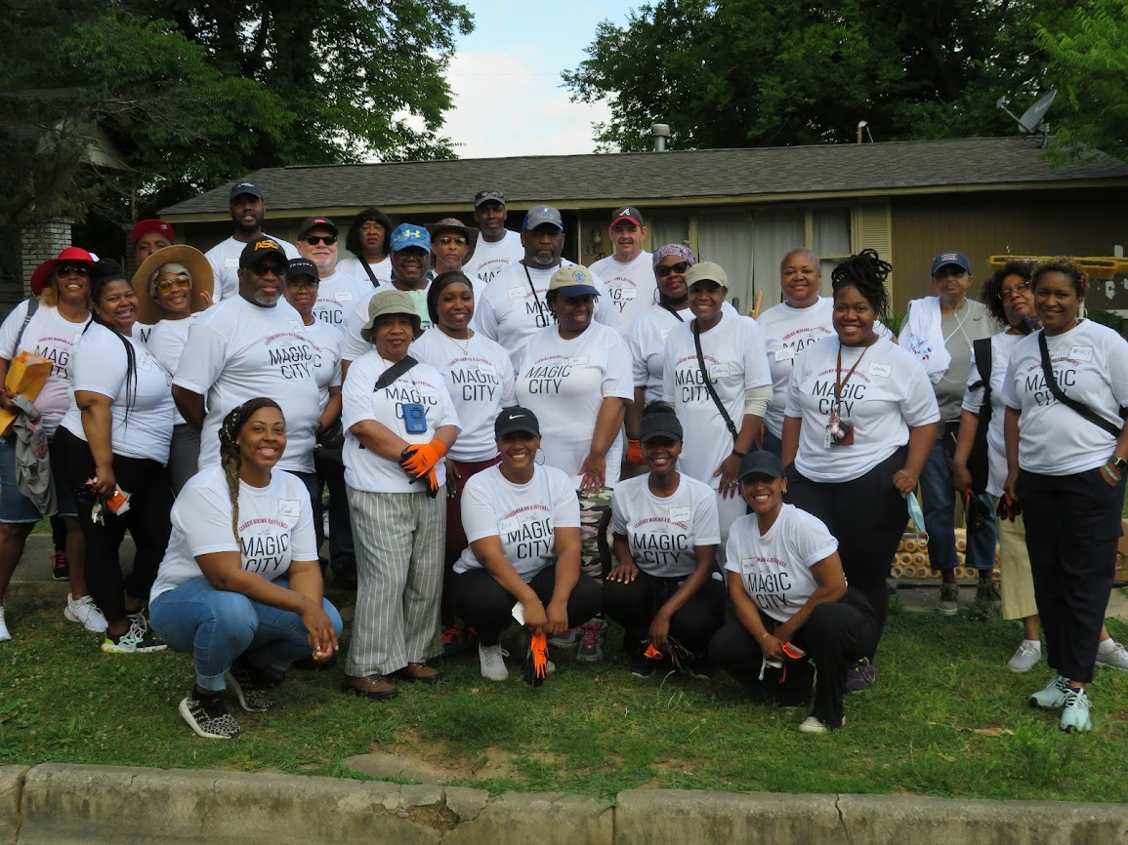
Community Development Team
42 full time employees

Slide 5
Who We Are!
8
Director,
Deputy Directors & Admin. Staff
10
Housing Rehab & Development Specialist
6
Grant Monitors, Auditors, & Compliance Specialists
5
Accounting Administration
6
Land Bank Administration & Project Coordinators
7
Neighborhood Services & Outreach Specialists
42
FTEs
Services, Home and
Jobs provided/created
with CD funding for
FY 2021-2023
20,250
Emergency Shelter/Homeless Services Provided through subrecipients
16,429
Public Service Activities and Events
284
Jobs created
Through Small Business Loans
COMMUNITY DEVELOPMENT SERVICES
3700
Households Assisted with Tenant-based Rental Assistance Services (ESG/HOPWA)
295
Households provided Affordable Units
1,010
Repair Services Provided to Homeowners During the Fiscal Year
200
Permanent Supportive Housing (PSH) Units in Rental facilities
or operated with HOPWA funds
50+%
of Beneficiaries Earning 30% MFI or Below were Assisted by Community Development Activities
CD‐5

Slide 6
HOUSING DEVELOPMENT COMMITMENTS
Project | Groundbreaking | Total Contribution | Funding Source | Estimated Units
Oak Hill | Mar 2022 | 540K | ARP | 27
Way Station | Aug 2022 | 1.3M | HOME/CARES | 40
Shadowbrook | Oct 2022 | 2.9M | DR | 52
Southtown | April 2023 | 4.4M | CDBG/HOME | 210
Wahouma | Rescheduled 2023 | 1.2M | HOME | 11
Woodlawn | March 2023 | 1.1M | CDBG/HOME/ ARP | 16
Own It (East Lake) | Spring 2023 | 600K | CDBG | 4
Smithfield (CNI) | Summer 2023 | 34M | CDBG/HOME/ HUD 108 | 900+
MicroShelter Pilot | TBD | 1M | ESG/ ARP | 90
Ensley | Winter 2023 | 1.2M | HOME | 100
Home Repairs | Complete | 1.5 M | CDBG | 80
Critical Repair 2 | July Launch | $4M | CDBG | 250
TOTAL |  | 53.6M |  | 1,764

